Slide 1
Oswald c
Single source shortest path - Dijkstra’s Algorithm
The class notes are a compilation and edition from many sources. The faculty does not claim intellectual property or ownership of the lecture notes. Thanks to them!

Slide 2
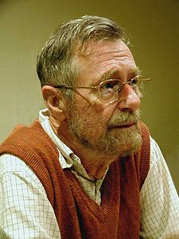
The author: Edsger Wybe Dijkstra(ACM Turing Award Winner)
"Computer Science is no more about computers than astronomy is about telescopes.“
http://www.cs.utexas.edu/~EWD/

Slide 3
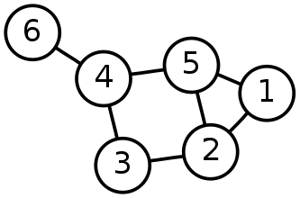
Single-Source Shortest Path Problem
Single-Source Shortest Path Problem - The problem of finding shortest paths from a source vertex v to all other vertices in the graph.

Slide 4
Dijkstra's algorithm
Dijkstra's algorithm - is a solution to the single-source shortest path problem in graph theory.
Works on both directed and undirected graphs. However, all edges must have nonnegative weights.
Approach: Greedy
Input: Weighted graph G={E,V} and source vertex v∈V, such that all edge weights are nonnegative
Output: Lengths of shortest paths (or the shortest paths themselves) from a given source vertex v∈V to all other vertices

Slide 5
Approach
The algorithm computes for each vertex u the distance to u from the start vertex v, that is, the weight of a shortest path between v and u.
the algorithm keeps track of the set of vertices for which the distance has been computed, called the cloud C
Every vertex has a label D associated with it. For any vertex u, D[u] stores an approximation of the distance between v and u. The algorithm will update a D[u] value when it finds a shorter path from v to u.
When a vertex u is added to the cloud, its label D[u] is equal to the actual (final) distance between the starting vertex v and vertex u.

Slide 6
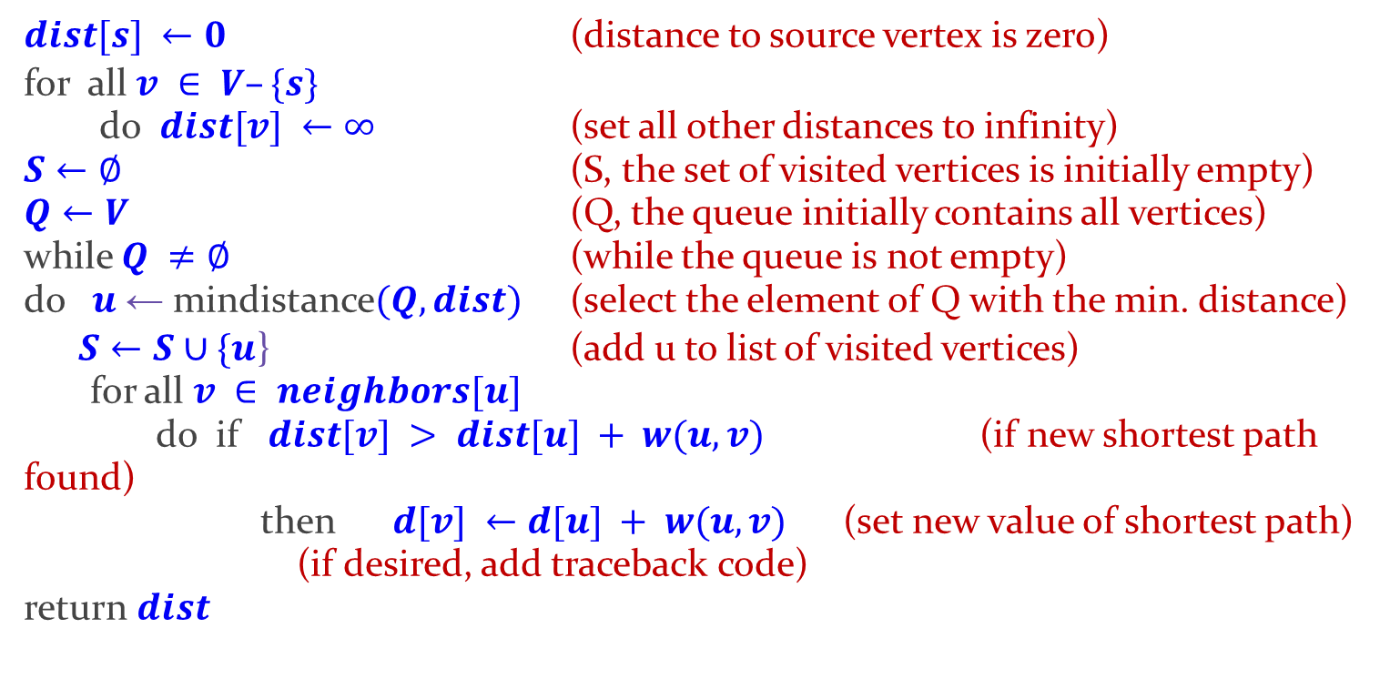
Dijkstra's algorithm - Pseudocode

Slide 7
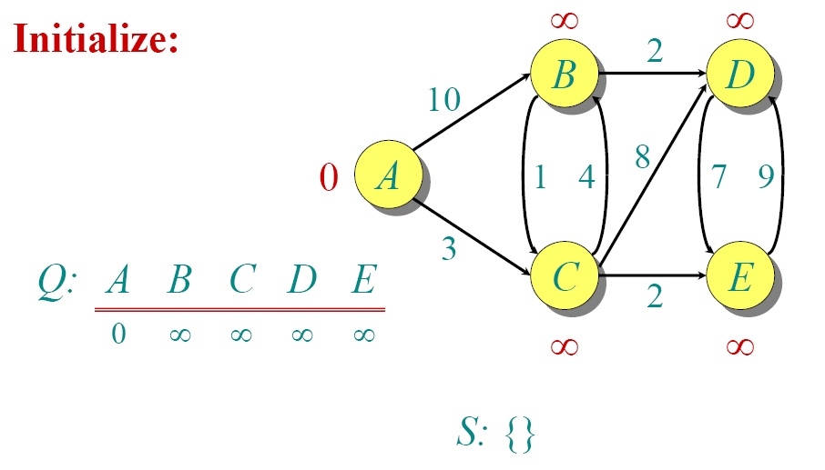
Dijkstra Animated Example 1

Slide 8
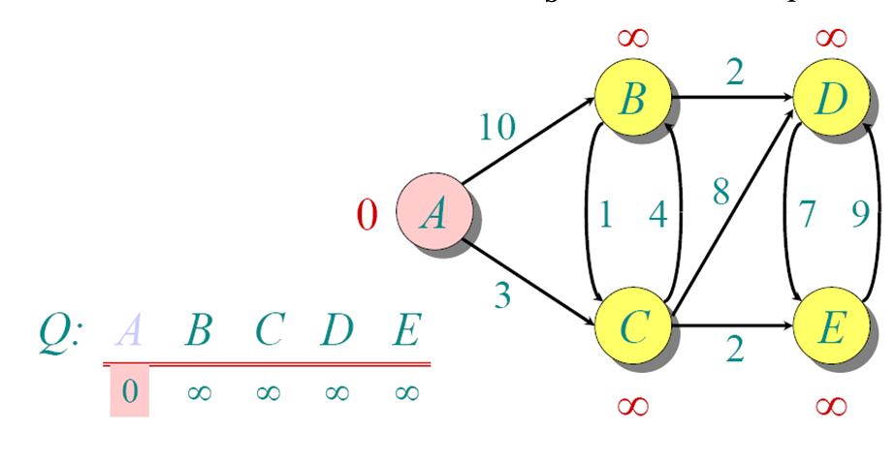
Dijkstra Animated Example 1

Slide 9
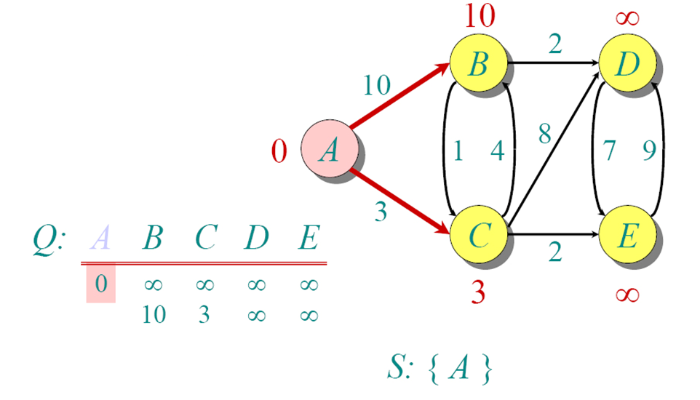
Dijkstra Animated Example 1

Slide 10
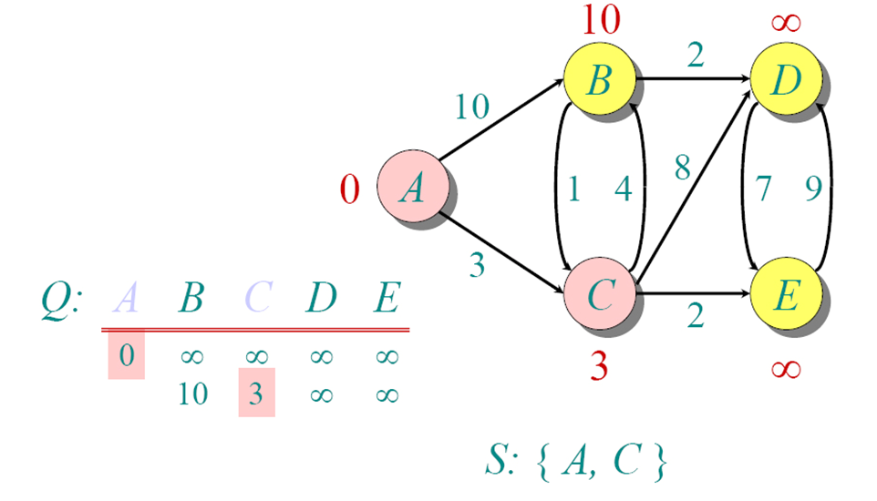
Dijkstra Animated Example 1

Slide 11
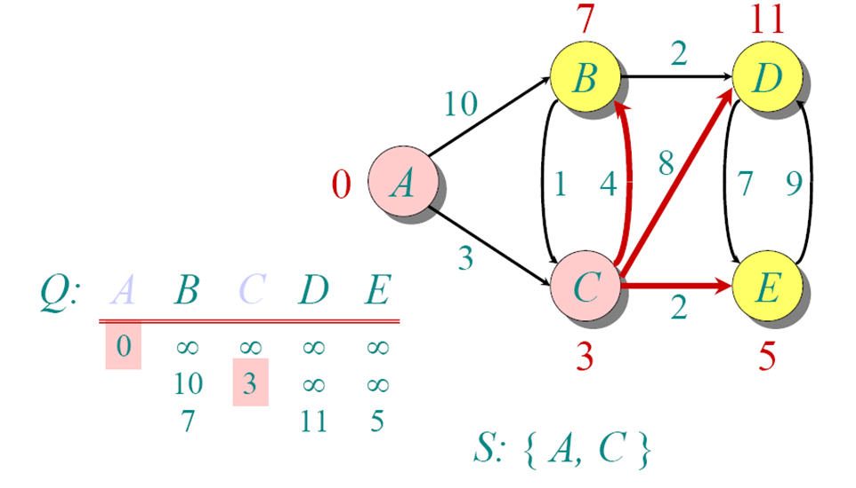
Dijkstra Animated Example 1

Slide 12
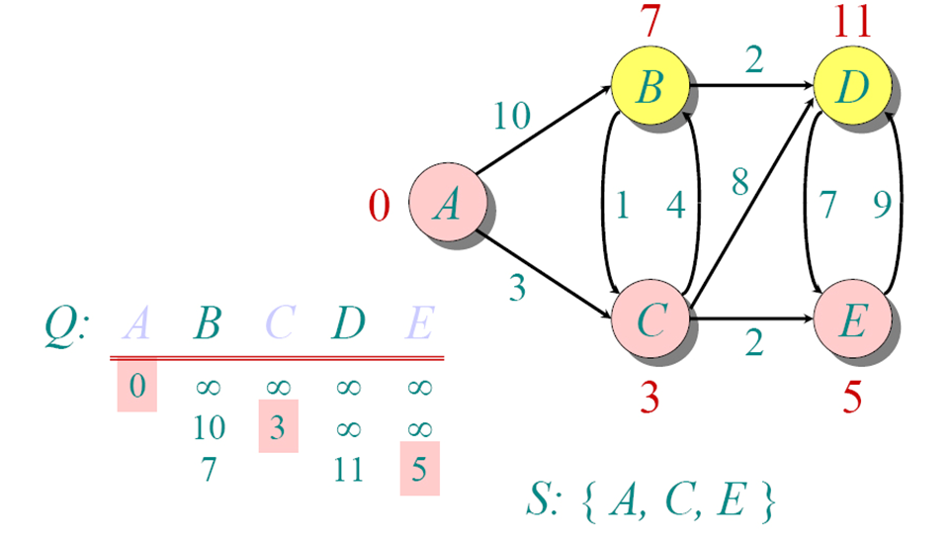
Dijkstra Animated Example 1

Slide 13
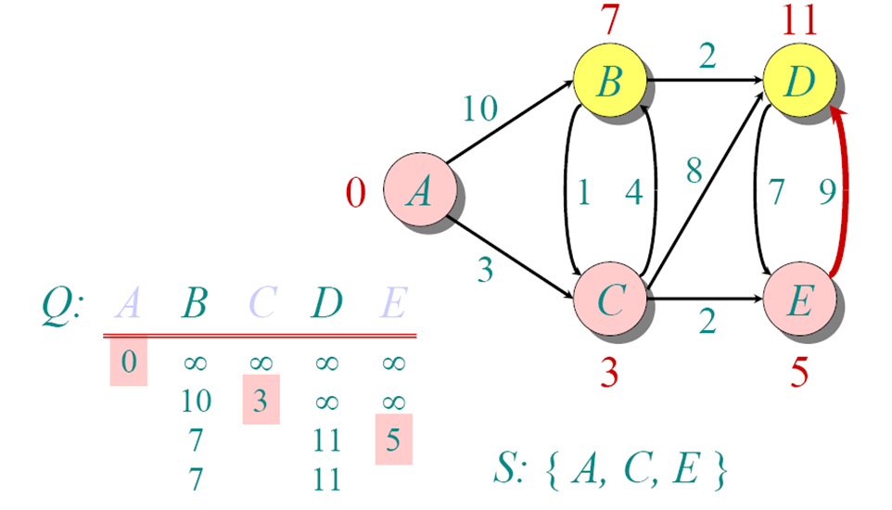
Dijkstra Animated Example 1

Slide 14
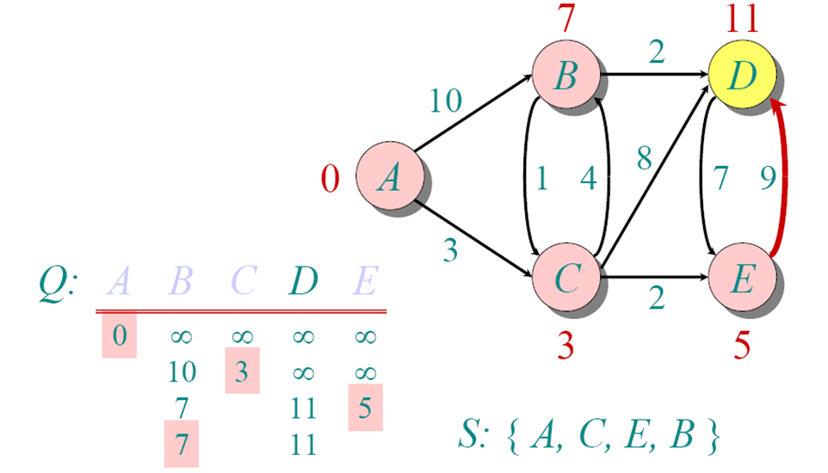
Dijkstra Animated Example 1

Slide 15
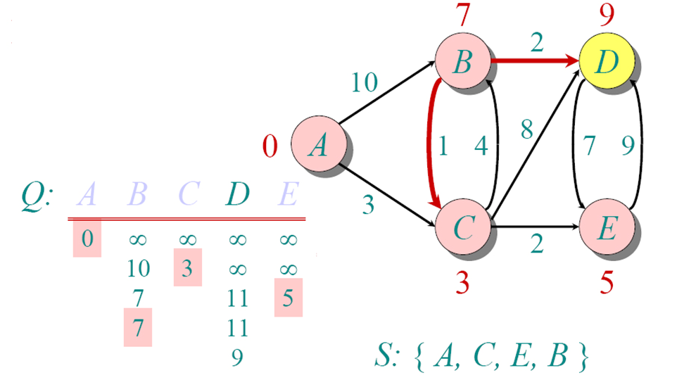
Dijkstra Animated Example 1

Slide 16
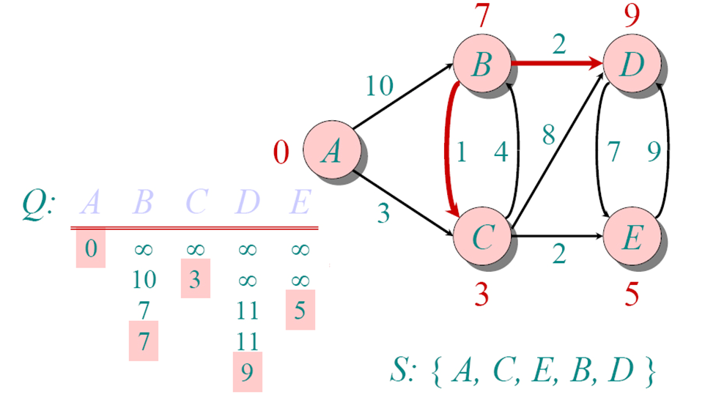
Dijkstra Animated Example 1

Slide 17
Dijkstra's Algorithm - Why It Works
As with all greedy algorithms, we need to make sure that it is a correct algorithm (e.g., it always returns the right solution if it is given correct input).
A formal proof would take longer than this presentation, but we can understand how the argument works intuitively.
If you can’t sleep unless you see a proof, see the second reference or ask us where you can find it.

Slide 18
Dijkstra's Algorithm - Why use it?
As mentioned, Dijkstra’s algorithm calculates the shortest path to every vertex.
However, it is about as computationally expensive to calculate the shortest path from vertex u to every vertex using Dijkstra’s as it is to calculate the shortest path to some particular vertex v.
Therefore, anytime we want to know the optimal path to some other vertex from a determined origin, we can use Dijkstra’s algorithm.

Slide 19
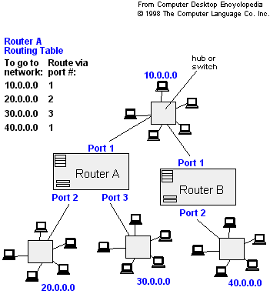
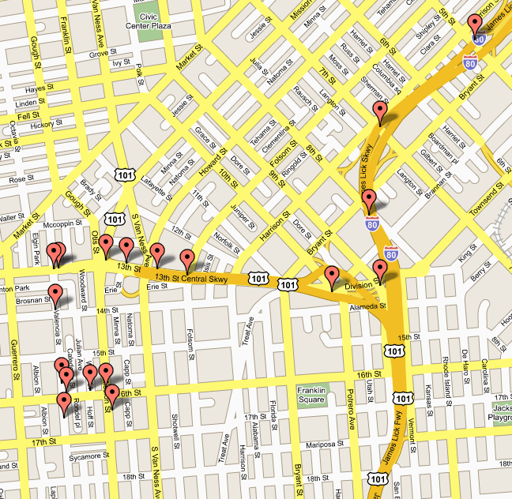
Applications of Dijkstra's Algorithm
- Traffic Information Systems are most prominent use
- Mapping (Map Quest, Google Maps)
- Routing Systems

Slide 20
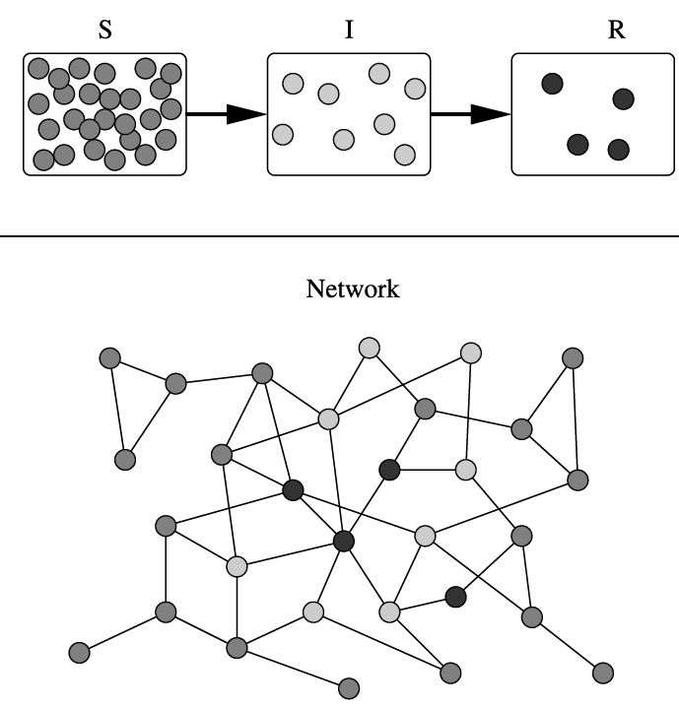
Applications of Dijkstra's Algorithm
One particularly relevant application: epidemiology
Biology uses networks to model the spread of infectious diseases and design prevention and response strategies.
Vertices represent individuals, and edges their possible contacts. It is useful to calculate how a particular individual is connected to others.
Knowing the shortest path lengths to other individuals can be a relevant indicator of the potential of a particular individual to infect others.

Slide 21
Time Complexity: Using List
The simplest implementation of the Dijkstra's algorithm stores vertices in an ordinary linked list or array
Good for dense graphs (many edges)
|V| vertices and |E| edges
Initialization O(|V|)
While loop O(|V|)
Find and remove min distance vertices O(|V|)
Potentially |E| updates
Update costs O(1)
Total time O(|V²| + |E|) = O(|V²| )

Slide 22
Time Complexity: Priority Queue
For sparse graphs, (i.e. graphs with much less than |V²| edges) Dijkstra's implemented more efficiently by priority queue
Initialization O(|V|) using O(|V|) buildHeap
While loop O(|V|)
Find and remove min distance vertices O(log |V|) using O(log |V|) deleteMin
Potentially |E| updates
Update costs O(log |V|) using decreaseKey
Total time O(|V|log|V| + |E|log|V|) = O(|E|log|V|)
|V| = O(|E|) assuming a connected graph

Slide 23
Dijkstra's Shortest Path Algorithm – Eg.2
Find shortest path from s to t.
2
24
3
9
s
18
14
6
6
2
30
4
19
11
15
5
5
6
20
16
7
t
44

Slide 24
Dijkstra's Shortest Path Algorithm
S = { }
PQ = { s, 2, 3, 4, 5, 6, 7, t }
∞
∞
2
24
3
0
9
s
∞
18
14
6
6
2
∞
30
∞
4
19
11
15
5
5
6
20
16
7
t
44
distance label
∞
∞

Slide 25
Dijkstra's Shortest Path Algorithm
S = { }
PQ = { s, 2, 3, 4, 5, 6, 7, t }
delmin
∞
∞
2
24
3
0
9
s
∞
18
14
6
6
2
∞
30
∞
4
19
11
15
5
5
6
20
16
7
t
44
distance label
∞
∞

Slide 26
Dijkstra's Shortest Path Algorithm
S = { s }
PQ = { 2, 3, 4, 5, 6, 7, t }
decrease key
∞
∞
9
X
2
24
3
0
9
s
∞
14
18
14
X
6
6
2
∞
30
∞
4
19
11
15
5
5
6
20
16
7
t
44
distance label
∞
15
∞
X

Slide 27
Dijkstra's Shortest Path Algorithm
S = { s }
PQ = { 2, 3, 4, 5, 6, 7, t }
delmin
∞
∞
9
X
2
24
3
0
9
s
∞
14
18
14
X
6
6
2
∞
30
∞
4
19
11
15
5
5
6
20
16
7
t
44
distance label
∞
15
∞
X

Slide 28
Dijkstra's Shortest Path Algorithm
S = { s, 2 }
PQ = { 3, 4, 5, 6, 7, t }
∞
∞
9
X
2
24
3
0
9
s
∞
14
18
14
X
6
6
2
∞
30
∞
4
19
11
15
5
5
6
20
16
7
t
44
∞
15
∞
X

Slide 29
Dijkstra's Shortest Path Algorithm
S = { s, 2 }
PQ = { 3, 4, 5, 6, 7, t }
decrease key
∞
33
∞
X
9
X
2
24
3
0
9
s
∞
14
18
14
X
6
6
2
∞
30
∞
4
19
11
15
5
5
6
20
16
7
t
44
∞
15
∞
X

Slide 30
Dijkstra's Shortest Path Algorithm
S = { s, 2 }
PQ = { 3, 4, 5, 6, 7, t }
∞
33
∞
X
9
X
2
24
3
0
9
delmin
s
∞
14
18
14
X
6
6
2
∞
30
∞
4
19
11
15
5
5
6
20
16
7
t
44
∞
15
∞
X

Slide 31
Dijkstra's Shortest Path Algorithm
S = { s, 2, 6 }
PQ = { 3, 4, 5, 7, t }
32
∞
33
∞
X
X
9
X
2
24
3
0
9
s
∞
14
18
14
X
6
6
2
44
∞
∞
4
30
X
19
11
15
5
5
6
20
16
7
t
44
∞
15
∞
X

Slide 32
Dijkstra's Shortest Path Algorithm
S = { s, 2, 6 }
PQ = { 3, 4, 5, 7, t }
32
∞
33
∞
X
X
9
X
2
24
3
0
9
s
∞
14
18
14
X
6
6
2
44
∞
∞
4
30
X
19
11
15
5
5
6
20
16
7
t
44
∞
15
delmin
∞
X

Slide 33
Dijkstra's Shortest Path Algorithm
S = { s, 2, 6, 7 }
PQ = { 3, 4, 5, t }
32
∞
33
∞
X
X
9
X
2
24
3
0
9
s
∞
14
18
14
X
6
6
2
44
35
∞
X
∞
4
30
X
19
11
15
5
5
6
20
16
7
t
44
59
∞
∞
15
X
X

Slide 34
Dijkstra's Shortest Path Algorithm
S = { s, 2, 6, 7 }
PQ = { 3, 4, 5, t }
delmin
32
∞
33
∞
X
X
9
X
2
24
3
0
9
s
∞
14
18
14
X
6
6
2
44
35
∞
X
∞
4
30
X
19
11
15
5
5
6
20
16
7
t
44
59
∞
∞
15
X
X

Slide 35
Dijkstra's Shortest Path Algorithm
S = { s, 2, 3, 6, 7 }
PQ = { 4, 5, t }
32
∞
33
∞
X
X
9
X
2
24
3
0
9
s
∞
14
18
14
X
6
6
2
44
35
34
∞
X
X
∞
4
30
X
19
11
15
5
5
6
20
16
7
t
44
51
59
∞
∞
15
X
X
X

Slide 36
Dijkstra's Shortest Path Algorithm
S = { s, 2, 3, 6, 7 }
PQ = { 4, 5, t }
32
∞
33
∞
X
X
9
X
2
24
3
0
9
s
∞
14
18
14
X
6
6
2
44
35
34
∞
X
X
∞
4
30
X
19
11
15
5
5
6
20
delmin
16
7
t
44
51
59
∞
∞
15
X
X
X

Slide 37
Dijkstra's Shortest Path Algorithm
S = { s, 2, 3, 5, 6, 7 }
PQ = { 4, t }
32
∞
33
∞
X
X
9
X
2
24
3
0
9
s
∞
14
18
14
X
6
6
2
35
34
45
∞
44
X
X
X
∞
4
30
X
19
11
15
5
5
6
20
16
7
t
44
50
51
59
∞
∞
15
X
X
X
X

Slide 38
Dijkstra's Shortest Path Algorithm
S = { s, 2, 3, 5, 6, 7 }
PQ = { 4, t }
32
∞
33
∞
X
X
9
X
2
24
3
0
9
s
∞
14
18
14
X
6
6
2
35
34
45
∞
44
X
X
X
∞
4
30
X
19
11
15
5
delmin
5
6
20
16
7
t
44
50
51
59
∞
∞
15
X
X
X
X

Slide 39
Dijkstra's Shortest Path Algorithm
S = { s, 2, 3, 4, 5, 6, 7 }
PQ = { t }
32
∞
33
∞
X
X
9
X
2
24
3
0
9
s
∞
14
18
14
X
6
6
2
35
34
45
∞
44
X
X
X
∞
4
30
X
19
11
15
5
5
6
20
16
7
t
44
50
51
59
∞
∞
15
X
X
X
X

Slide 40
Dijkstra's Shortest Path Algorithm
S = { s, 2, 3, 4, 5, 6, 7 }
PQ = { t }
32
∞
33
∞
X
X
9
X
2
24
3
0
9
s
∞
14
18
14
X
6
6
2
35
34
45
∞
44
X
X
X
∞
4
30
X
19
11
15
5
5
6
20
16
7
t
44
delmin
50
51
59
∞
∞
15
X
X
X
X

Slide 41
Dijkstra's Shortest Path Algorithm
S = { s, 2, 3, 4, 5, 6, 7, t }
PQ = { }
32
∞
33
∞
X
X
9
X
2
24
3
0
9
s
∞
14
18
14
X
6
6
2
35
34
45
∞
44
X
X
X
∞
4
30
X
19
11
15
5
5
6
20
16
7
t
44
50
51
59
∞
∞
15
X
X
X
X

Slide 42
Dijkstra's Shortest Path Algorithm
S = { s, 2, 3, 4, 5, 6, 7, t }
PQ = { }
32
∞
33
∞
X
X
9
X
2
24
3
0
9
s
∞
14
18
14
X
6
6
2
35
34
45
∞
44
X
X
X
∞
4
30
X
19
11
15
5
5
6
20
16
7
t
44
50
51
59
∞
∞
15
X
X
X
X

Slide 43
Example 3 – Try it out!
u
v
1
10
∞
∞
9
s
0
2
3
4
6
7
5
∞
∞
2
x
y

Slide 44

Who was Dijkstra?
What were his major contributions?

Slide 45

http://www.cs.utexas.edu/users/EWD/
Edsger Wybe Dijkstra was one of the most influential members of computing science's founding generation. Among the domains in which his scientific contributions are fundamental are
algorithm design
programming languages
program design
operating systems
distributed processing
formal specification and verification
design of mathematical arguments

Slide 46
References
Dijkstra’s original paper: E. W. Dijkstra. (1959) A Note on Two Problems in Connection with Graphs. Numerische Mathematik, 1. 269-271.
MIT OpenCourseware, 6.046J Introduction to Algorithms. < http://ocw.mit.edu/OcwWeb/Electrical-Engineering-and-Computer-Science/6-046JFall-2005/CourseHome/> Accessed 4/25/09
Meyers, L.A. (2007) Contact network epidemiology: Bond percolation applied to infectious disease prediction and control. Bulletin of the American Mathematical Society 44: 63-86.
Department of Mathematics, University of Melbourne. Dijkstra’s Algorithm. <http://www.ms.unimelb.edu.au/~moshe/620-261/dijkstra/dijkstra.html > Accessed 4/25/09

Slide 47
Some Applications of Graphs

Slide 48
Graph Coloring Problem
Graph coloring is an assignment of "colors", almost always taken to be consecutive integers starting from 1 without loss of generality, to certain objects in a graph. Such objects can be vertices, edges, faces, or a mixture of the above.
Graph coloring is a tool used for the assignment of tasks without any overlapping.
Application examples: scheduling, register allocation in a microprocessor, frequency assignment in mobile radios, and pattern matching

Slide 49
Vertex Coloring Problem
Assignment of colors to the vertices of the graph such that proper coloring takes place (no two adjacent vertices are assigned the same color)
Chromatic number: least number of colors needed to color the graph
A graph that can be assigned a (proper) k-coloring is k-colorable, and it is k-chromatic if its chromatic number is exactly k.

Slide 50
Vertex Coloring Problem
The problem of finding a minimum coloring of a graph is NP-Hard
The corresponding decision problem (Is there a coloring which uses at most k colors?) is NP-complete
The chromatic number for C_{n} = 3 (n is odd) or 2 (n is even), K_{n} = n, K_{m,n} = 2
Cn: cycle with n vertices; Kn: fully connected graph with n vertices; Km,n: complete bipartite graph
C₄
C₅
K₄
K_{2, 3}

Slide 51
☺
And he talked for forty-five minutes, and nobody understood a word that he said, but we had fun fillin’ out the forms and playin’ with the pencils on the bench there…

Slide 52
Few References
[1]“6.042J Chapter 5: Graph theory - MIT6_042JF10_chap05.pdf.” [Online]. Available: http://ocw.mit.edu/courses/electrical-engineering-and-computer-science/6-042j-mathematics-for-computer-science-fall-2010/readings/MIT6_042JF10_chap05.pdf. [Accessed: 28-Aug-2013].
[2] reading: Weiss Ch. 9.
[3] Data structures with C++ using STL by Ford, William; Topp, William; Prentice Hall.
[4] Introduction to Algorithms by Cormen, Thomas et. al., The MIT press.

